Slide 1
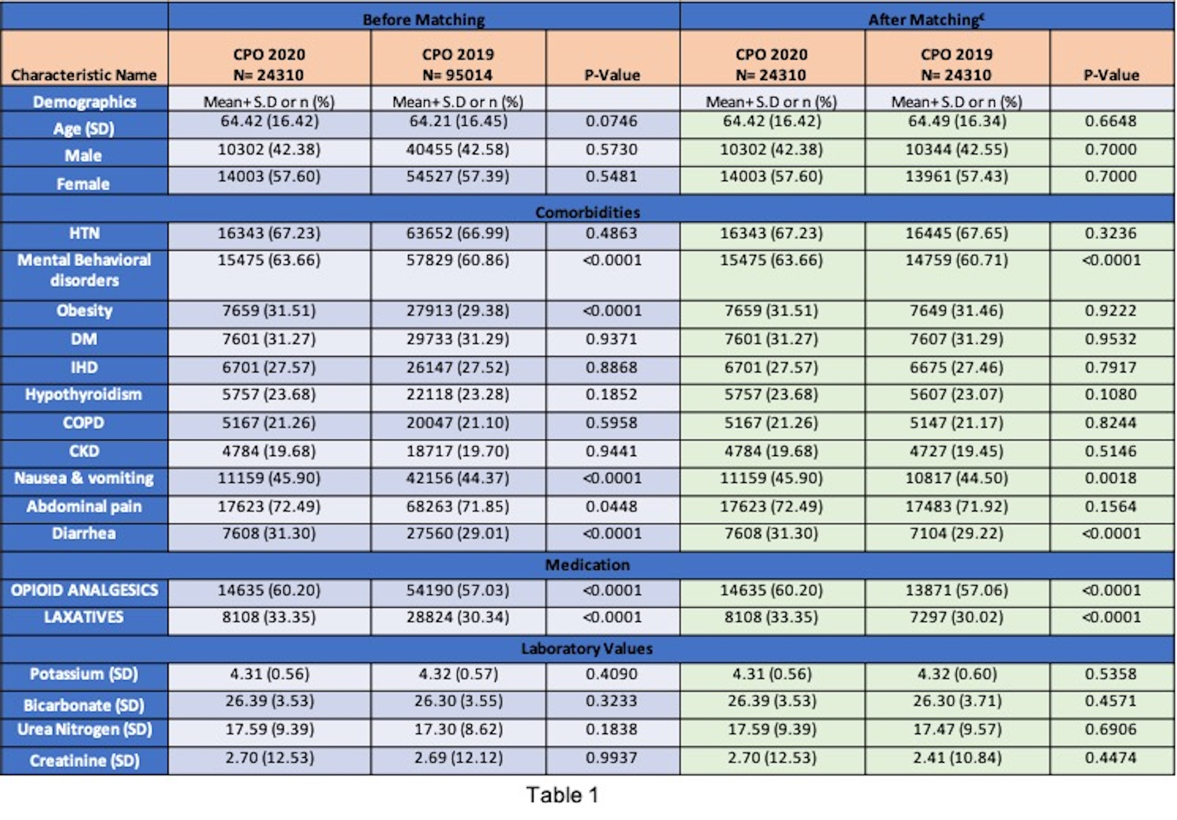
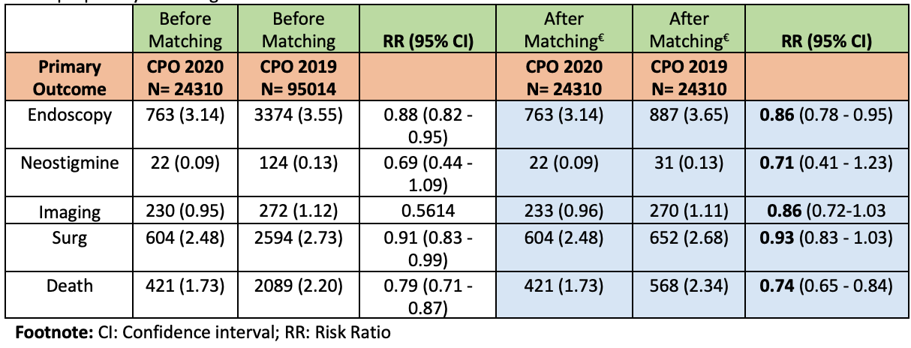
GASTROINTESTINAL BLEEDING RISK AND ENDOSCOPYUTILIZATION IN COVID-19 PATIENTS ON THERAPEUTIC ANTICOAGULATION: A MULTICENTRIC STUDY Abhilash Perisetti, MD¹; Hemant Goyal, MD⁴; Rachana Yendala, MD³; Syed Mahanazuddin, PhD²; Mariajose Rojas, MD¹; Mahesh Gajendran, MD⁵; Benjamin Tharian, MD²; and Neil Sharma, MD¹ ¹Parkview Cancer Institute, Fort Wayne, IN, ²University of Arkansas for Medical Sciences, Little Rock, AR, ³Conway Regional Medicine, ⁴Wright School of Medicine, and ⁵Texas Tech Health Science Center, El Paso, TX
TABLES
RESULTS
BACKGROUND
Patients affected with coronavirus disease 2019 (COVID-19) can lead to severe hypercoagulability. Many of these patients receive therapeutic anticoagulation because of a very high risk of thromboembolism.
This study aims to evaluate the rates of GIB bleeding in COVID-19 patients and the endoscopy utilization for the same from a national research network database.
A total of 104,946 patients in COVID with AC and 591,273 patients in COVID w/o AC groups were compared. The patient comorbidities at presentation, laboratory findings, and clinical outcomes are noted in Table 1.
After matching, COVID with AC patients had a higher risk of GIB (risk ratio [RR]- 1.62 (CI- 1.45 - 1.82)),inpatient hospitalization rates (RR- 4.53 (CI- 4.42 - 4.65)), PRBC transfusions (RR 3.67 (CI-3.35 - 4.02)), overall mortality (RR 3.93 (3.75 - 4.12)). Despite the increased presence of GIB, endoscopy utilization was lower (RR-0.85 (0.78 - 0.93)).
Table 1: Baseline characteristics and clinical outcomes in CPO in 2020 compared to CPO in 2019
METHODS
All adults patients who were on therapeutic anticoagulation(warfarin, therapeutic dose-heparin [enoxaparin, unfractionated heparin], direct thrombin inhibitors, direct-acting factor Xa inhibitors 3-months prior to COVID-19 diagnosis.
Patients with the above characteristics were studied from January 1,2020, to June 15, 2021, were divided into the anticoagulation (COVID with AC) and without anticoagulation(COVID w/o AC) groups.
The primary outcomes were rates of GIB (melena/hematemesis), inpatient hospitalizations, endoscopy(EGD/colonoscopy) utilization, number of packed red blood cell (PRBC) transfusions, and 30-day all-cause mortality.
CONCLUSION
Rates of GIB, inpatient hospitalization, and overall mortality increased in COVID-19 patients on therapeutic anticoagulation. However, endoscopy utilization remained low, probably due to fear of infection transmission.
Table 2: Clinical Outcomes in the subgroup analysis based on patients with CPO in 2020 to CPO in 2019 after propensity matching
1
Notes:
Rates of GIB, inpatient hospitalization, and overall mortality increased in COVID-19 patients on therapeutic anticoagulation. However, endoscopy utilization remained low, probably due to fear of infection transmission.

