Slide 1
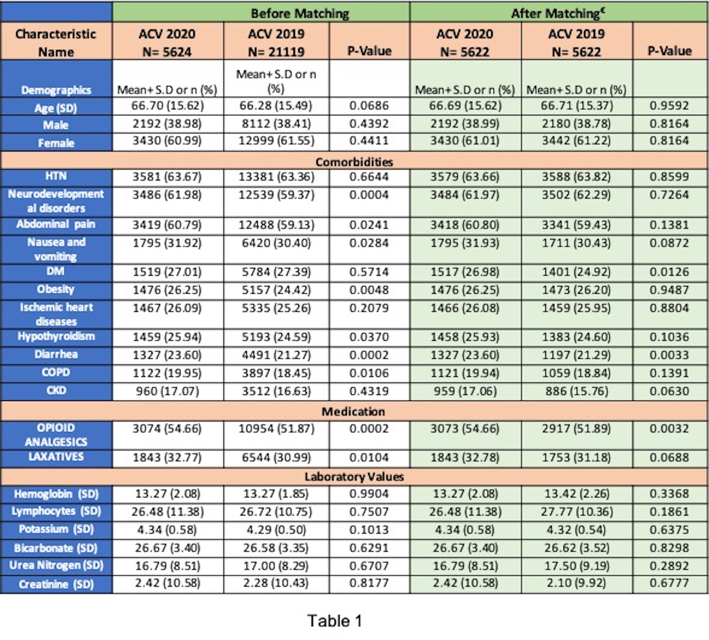
Effect of Pandemic on Endoscopic Utilization in Colonic Volvulus: A Global Multicentric Study Abhilash Perisetti, MD¹; Hemant Goyal, MD⁴; Syed Mahanazuddin, PhD²; Saurabh Chandan, MD³; Ruthvik Allala, BA⁵; Mariajose Rojas, MD¹; Jonathan Kopel, PhD⁶; Sonali Sachdeva, MBBS⁷; Mark M Aloysius⁴; Benjamin Tharian, MD²; and Neil Sharma, MD¹ ¹Parkview Cancer Institute, Fort Wayne, IN, ²University of Arkansas for Medical Sciences, Little Rock, AR, ³Creighton University School of Medicine, ⁴Wright School of Medicine, ⁵UNTHSC school of Medicine, ⁶Texas Tech University Health Sciences and ⁷Boston University Medical Center,
TABLES
RESULTS
BACKGROUND
A total of 5,624 patients were hospitalized with ACV in 2020 compared to 21,119 patients in 2019 with a
reduction of 73.4%. Comorbidities of these patients at presentation, laboratory findings, and clinical
outcomes are noted in Table 1.
The mean age at presentation was 66.7 years (SD- 15.6 years). Patients with
obesity, chronic use of opioid medications, and laxatives had a higher risk of ACV.
After matching, rates of endoscopy utilization (risk ratio [RR]- 1.2 (CI- 0.77 - 1.82)), abdominal cross-sectional imaging rates (RR 0.96
(CI- 0.54 – 1.70)) did not differ between two groups. Furthermore, no change in mortality was noted in the
2020 ACV group compared to the 2019 group (RR- 1.01 (0.78 – 1.34)).
The rates of ACV reduced significantly by 73.4% in 2020 compared to 2019. Despite the potential risk of
infection transmission, the utilization of endoscopy, abdominal cross-sectional did not differ during the
pandemic.
Chronic use of opioids continues to be a major risk factor for ACV.
There was no change in mortality rates in ACV 2020 compared to ACV 2019.
Acute colonic volvulus (ACV) is a gastrointestinal emergency that results from the torsion of a segment of the
colon either at the level of the sigmoid colon or cecum
The data about endoscopy utilization in a gastrointestinal emergency during the pandemic such as ACV is unclear.
Table 1: Baseline characteristics and clinical outcomes in acute colonic volvulus (ACV) patients in 2020 compared to ACV patients in 2019
METHODS
All adult patients admitted with ACV in the year 2020, were compared to the ACV patients hospitalized in 2019 using TriNetX retrospective patient sample. Patients with pseudo colonic obstruction and megacolon were excluded.
The primary outcomes were rates of endoscopy (sigmoidoscopy/colonoscopy) utilization and all-cause 30-day mortality.
The clinical outcomes were measured after 1:1 propensity matching of the groups based on the baseline
demographics and comorbidities.
CONCLUSION
Table 2: Clinical Outcomes in the subgroup analysis based on patients with acute colonic volvulus (ACV) in 2020 to ACV in 2019 after propensity matching
1
References
Perisetti, A., Gajendran, M., Boregowda, U., Bansal, P., & Goyal, H. (2020). COVID‐19 and
gastrointestinal endoscopies: current insights and emergent strategies. Digestive Endoscopy, 32(5), 715-722.
Notes:
Baseline characteristics and clinical outcomes in acute colonic volvulus (ACV) patients in 2020 compared to ACV patients in 2019

