Slide 1
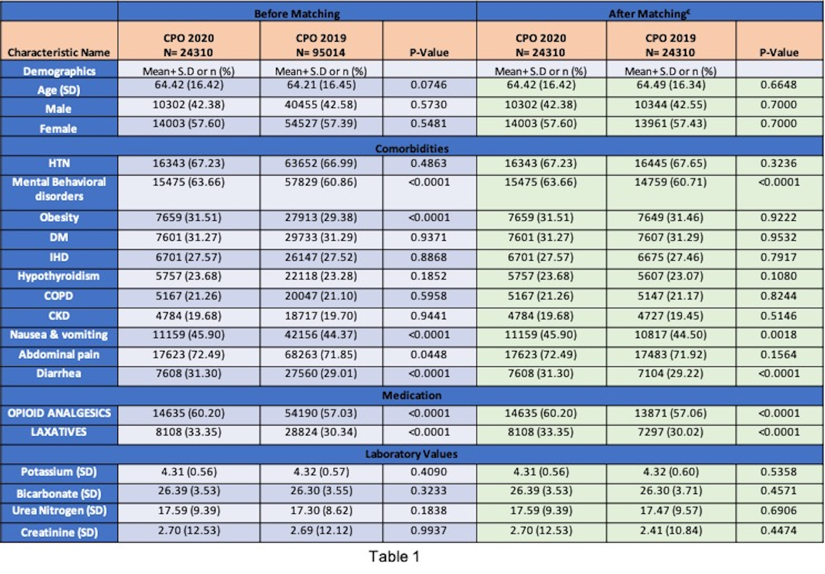
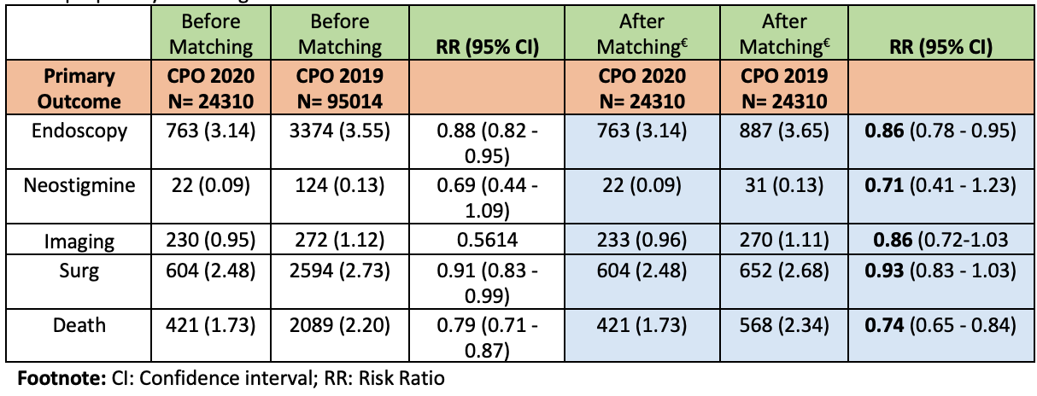
IMPACT OF PANDEMIC ON EPIDEMIOLOGY ANDMANAGEMENT OF ACUTE COLONIC PSEUDO OBSTRUCTION: NATIONWIDECLINICAL DATA RESEARCH NETWORK Abhilash Perisetti, MD¹; Hemant Goyal, MD⁴; Syed Mahanazuddin, PhD²; Mariajose Rojas, MD¹; Mahesh Gajendran, MD⁵; Syed Ali Amir Sheraji, MD⁶; Swetha Gupta, MD⁶; Ragesh Thandassery, MD²; Benjamin Tharian, MD²; and Neil Sharma, MD¹ ¹Parkview Cancer Institute, Fort Wayne, IN, ²University of Arkansas for Medical Sciences, Little Rock, AR, ³Conway Regional Medicine, ⁴Wright School of Medicine, ⁵Texas Tech Health Science Center, El Paso, TX and ⁶John H Stroger Hospital Cook County.
TABLES
RESULTS
BACKGROUND
A total of 24,310 patients were diagnosed with ACPO in 2020 compared to 95,014 with a reduced incidence of74.5%. Comorbidities of these patients at presentation and clinical outcomes are noted in Table 1.
Patients with behavioral/neurodevelopmental disorders, obesity, opioid use and laxative were significantly higher in ACPO patients.
After matching, rates of neostigmine use (risk ratio [RR]- 0.71 (CI- 0.41 – 1.23)), imaging(CT/MRI) (RR- 0.86 (CI- 0.72 – 1.03)), surgery ((RR- 0.93 (CI- 0.83 – 1.03)) did not differ between the groups. Endoscopic utilization reduced significantly in 2020 (RR- 0.86 (CI- 0.78 – 0.95)). Furthermore, mortality was low in 2020 group (RR- 0.74 (CI- 0.65 – 0.84)).
The rates of ACPO diagnosis in 2020 reduced by 74.5% compared to 2019. Although the neostigmine use, cross-sectional imaging use, and surgery rates did not change, endoscopic utilization was reduced by 15%.
Acute colonic pseudo-obstruction (ACPO), also known as Ogilvie’s syndrome, is characterized by massive acute dilatation of the large intestine without a mechanical cause.
COVID-19 pandemic led toa significant shift of resources for the treatment of patients with reduced utilization of endoscopy and imaging, which could have impacted outcomes in patients with ACPO.
Table 1: Baseline characteristics and clinical outcomes in CPO in 2020 compared to CPO in 2019
METHODS
All adult patients with a new diagnosis of intestinal obstruction without mechanical cause were identified using ICD-10 codes (K59.8, K56.69). Patients diagnosed with megacolon (K59.3) were excluded. Patients were included from TriNetX, a federated cloud-based network that comprises 92 healthcare organizations across the entire US.
The primary outcomes were rates of pharmacological therapy (neostigmine use), lower GI endoscopicdecompression (Colonoscopy/sigmoidoscopy), surgery (laparotomy), and overall 30 day- mortality.
CONCLUSION
Table 2: Clinical Outcomes in the subgroup analysis based on patients with CPO in 2020 to CPO in 2019 after propensity matching
References
1
Perisetti, A., Gajendran, M., Boregowda, U., Bansal, P., & Goyal, H. (2020). COVID‐19 and
gastrointestinal endoscopies: current insights and emergent strategies. Digestive Endoscopy, 32(5), 715-722.
Notes:
Table 1: Baseline characteristics and clinical outcomes in CPO in 2020 compared to CPO in 2019

