Slide 1
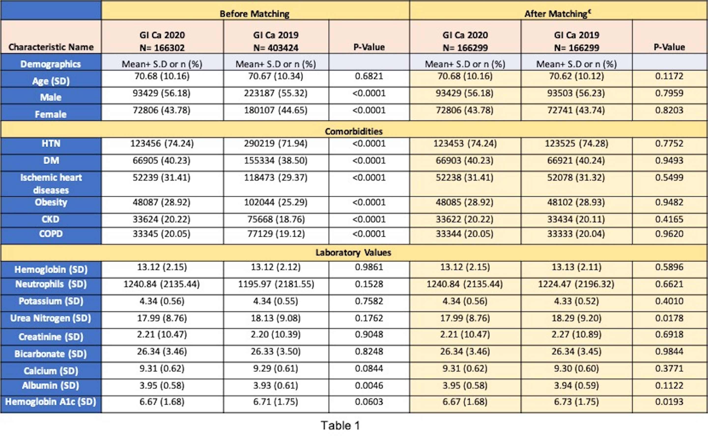
Reduced Incidence of New Gastrointestinal Cancers Diagnosis During COVID-19 Pandemic Abhilash Perisetti, MD¹; Syed Mahanazuddin, PhD²; Rachana Yendala, MD³; Hemant Goyal, MD⁴; ; Mariajose Rojas, MD¹; Benjamin Tharian, MD²; and Neil Sharma, MD¹ ¹Parkview Cancer Institute, Fort Wayne, IN, ²University of Arkansas for Medical Sciences, Little Rock, AR, ³Conway Regional Medicine and ⁴Wright School of Medicine
TABLES
RESULTS
BACKGROUND
A total of 166,302 patients were diagnosed with GI cancers (colon cancer followed by pancreas, liver, stomach, esophagus in descending order) in 2020 compared to 403,424 patients in 2019. There was a reduction of 41.2% in the diagnosis of new GI cancers in 2020.
Comorbidities of these patients at presentation and clinical outcomes are noted in Table 1.
After matching, rates of endoscopy utilization (risk ratio [RR]- 0.70 (CI- 0.67 – 0.74)), EUS/ERCP (RR 0.58 (CI:0.52–0.64)), CT/MRI (RR 0.95 (CI:0.90–1.00)) were lower in 2020 compared to 2019 group. 30-day all-cause mortality was also lower in 2020 group (RR 0.82 (CI- 0.79 –0.86)).
The rates of new GI cancers incidence decreased by 41.2% during 2020 compared to 2019. Moreover, endoscopy utilization was reduced by 30-42% during the pandemic.
These findings are probably related to reduced endoscopy rates utilized for cancer screening.
Gastrointestinal cancers such as esophageal, gastric, colon, liver, and pancreas cancers present a significant global challenge.
COVID-19 pandemic led to a strain on multiple healthcare systems resulting in stay-at-home restraints, which might have impacted early recognition of these cancers. The data about the the incidence of GI cancers during the pandemic is scarce.
Table 1: Baseline characteristics and clinical outcomes in GI cancers 2020 compared to GI cancers 2019
METHODS
CONCLUSION
All adult patients with a new diagnosis of GI cancers in 2020 were compared with the patients in 2019. ICD-10codes were utilized to identify these patient from TriNetX, a federated cloud-based network that comprises92 healthcare organizations across the US.
The primary outcome of the study was rates of GI cancer diagnoses. The secondary outcomes were GI endoscopy (EGD/sigmoidoscopy/colonoscopy) utilization, rates of endoscopic ultrasound (EUS), and endoscopic retrograde cholangiopancreatography (ERCP), rates of CT/MRI imaging, and overall mortality.
Table 2: Clinical Outcomes in the subgroup analysis based on patients with GI Ca in 2020 to GI Ca in 2019 after propensity matching
References
1
Perisetti, A., Gajendran, M., Boregowda, U., Bansal, P., & Goyal, H. (2020). COVID‐19 and
gastrointestinal endoscopies: current insights and emergent strategies. Digestive Endoscopy, 32(5), 715-722.
Notes:
Table 1: Baseline characteristics and clinical outcomes in GI cancers 2020 compared to GI cancers 2019

